Slide 1
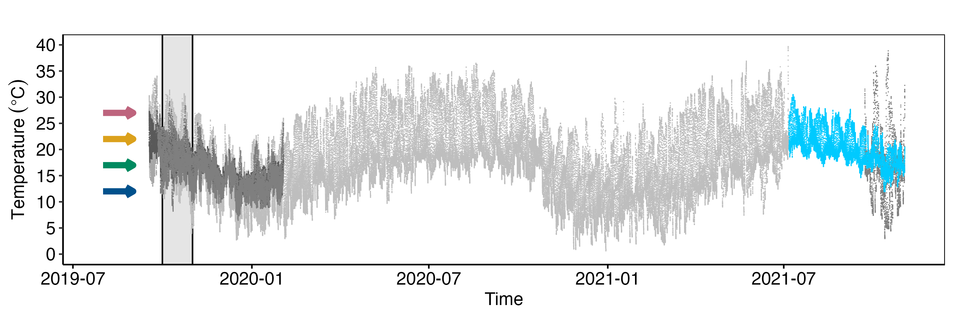
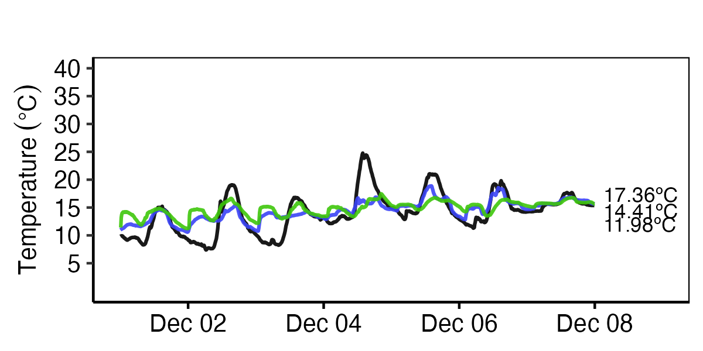
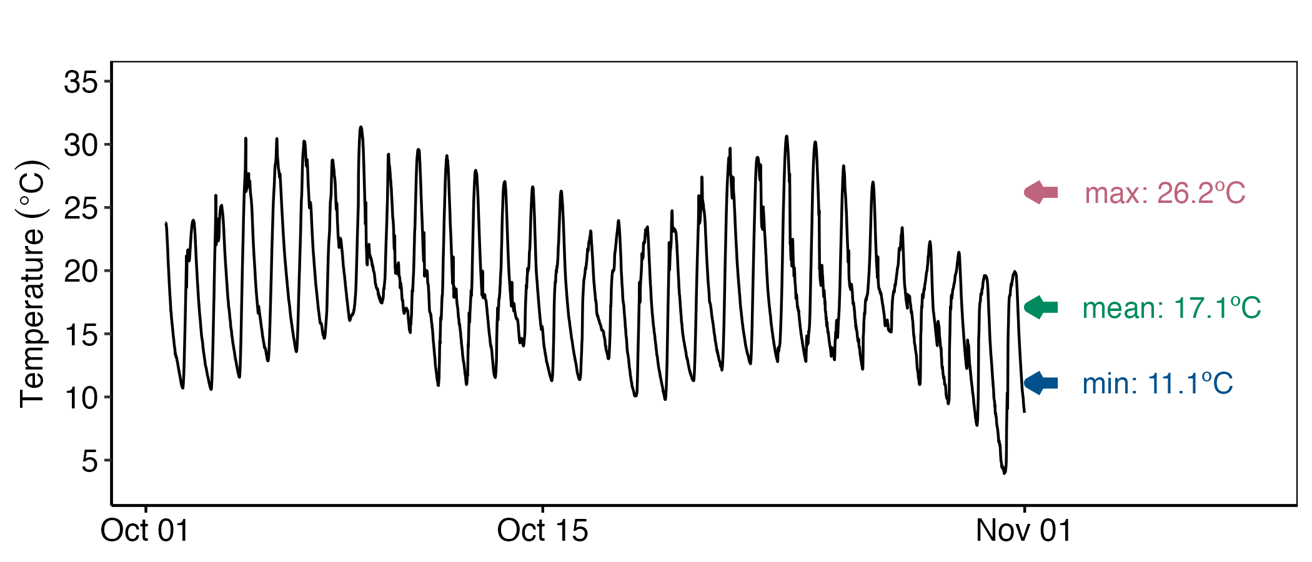
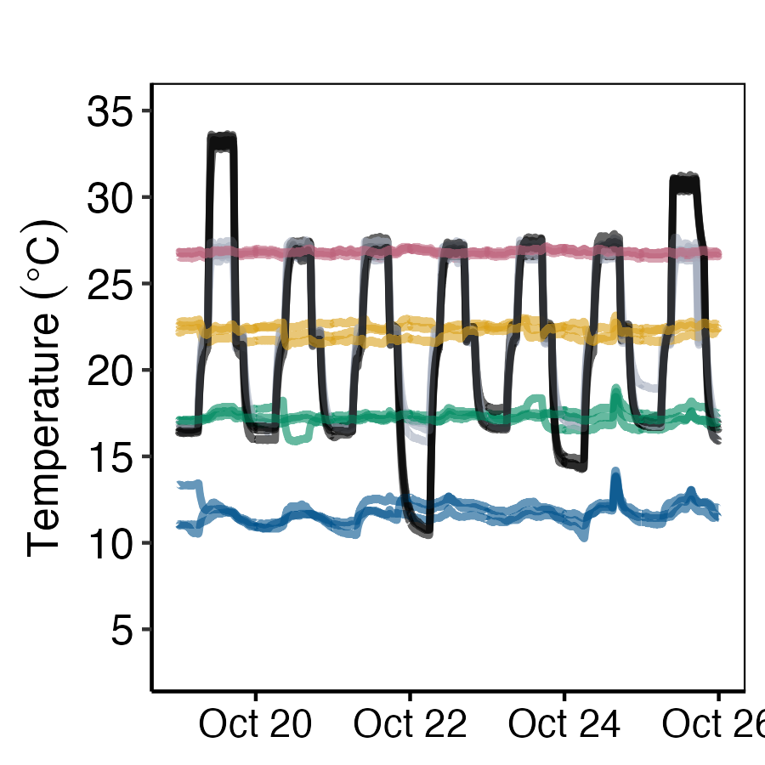
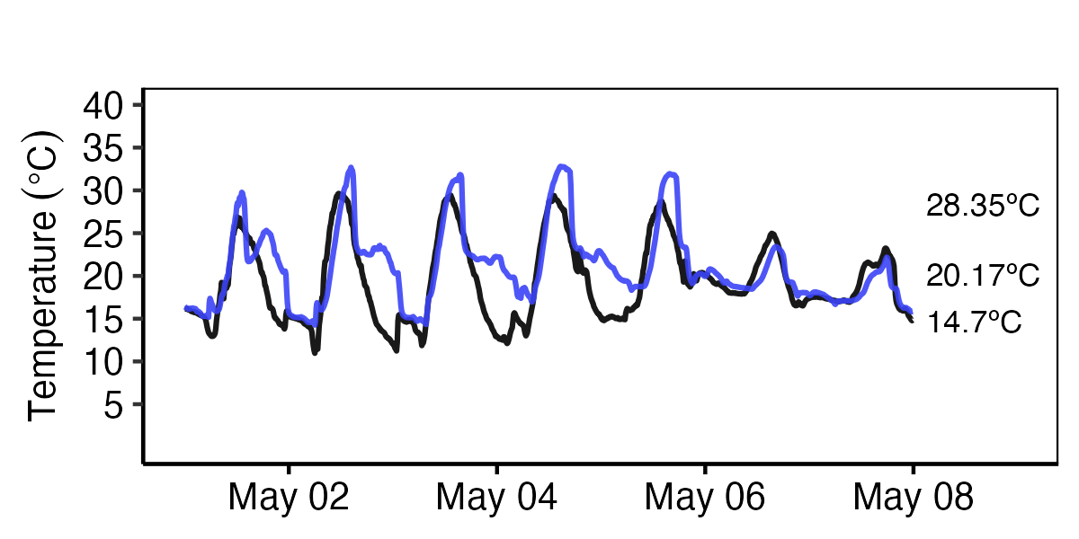
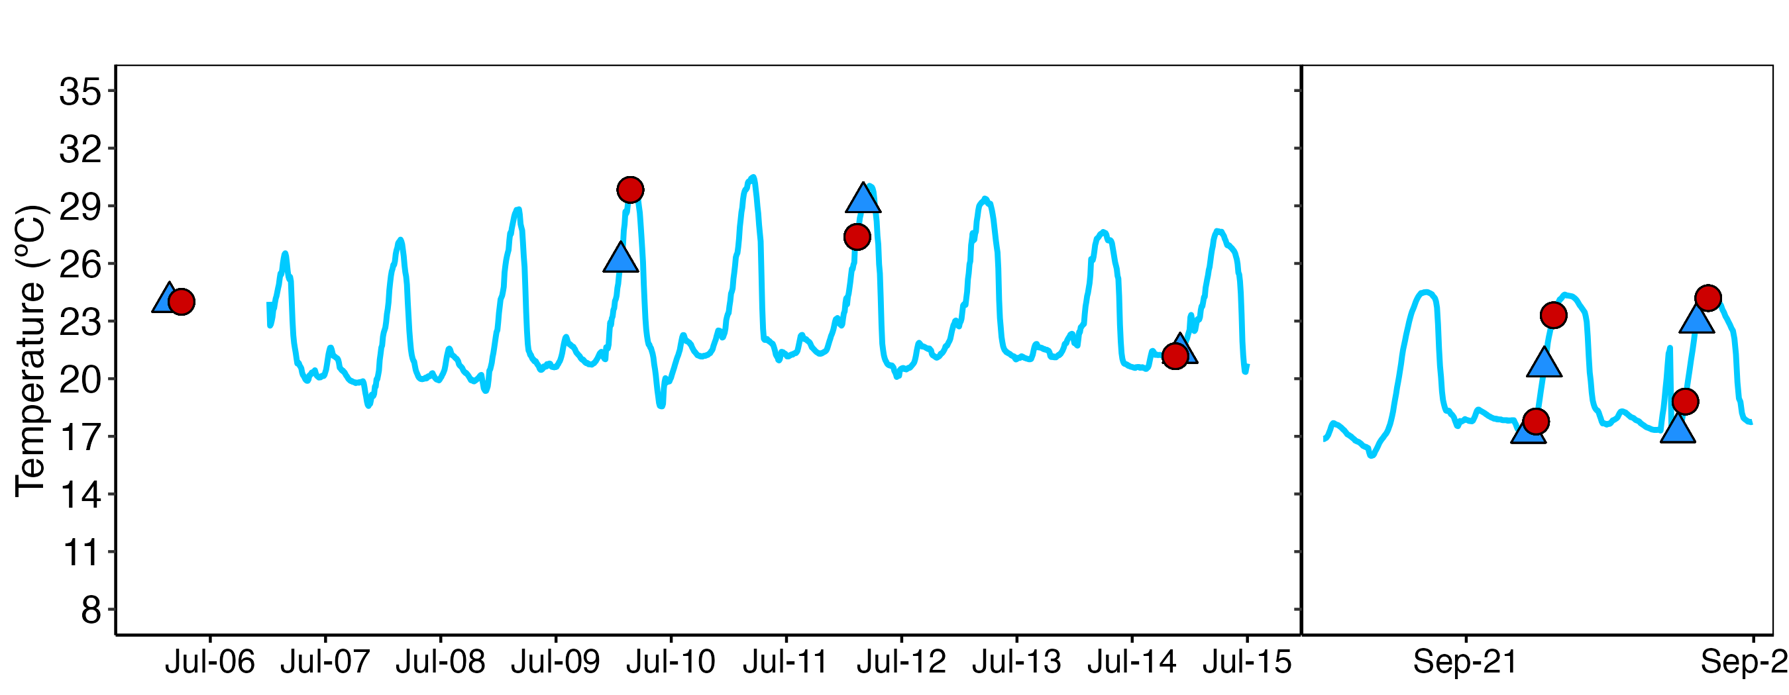
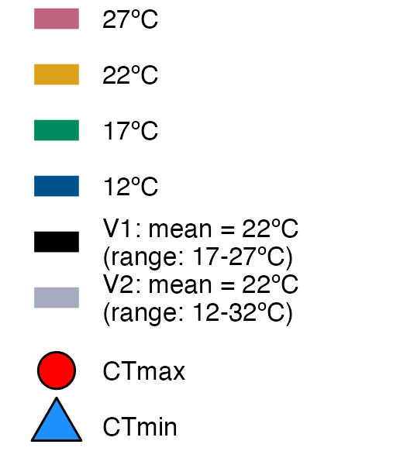
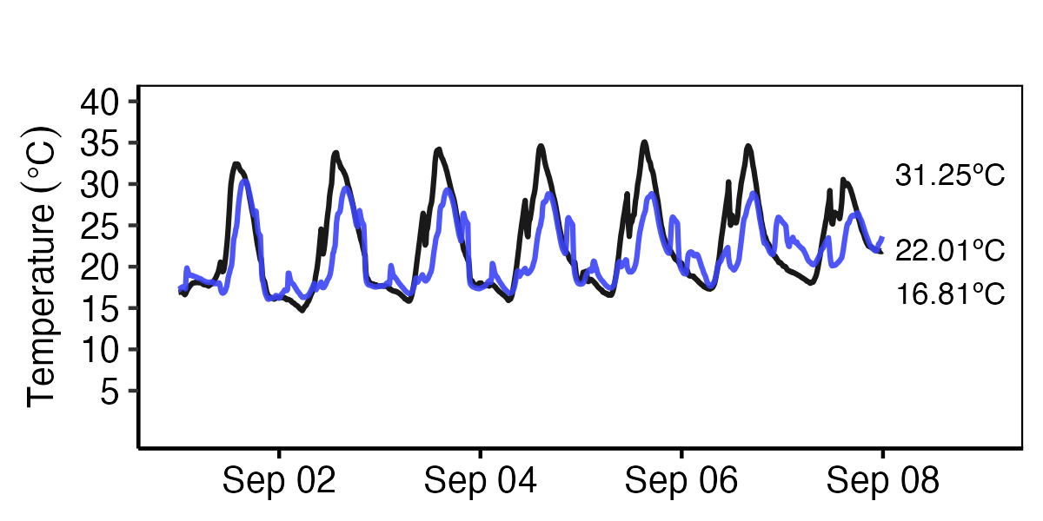
A
Field test site
Site1
December 2019
Field informed → Lab acclimation
B
B
May 2020
C
C
Field acclimatization
September 2020

Slide 2
May 2020
December 2019
September 2020
Site | Daily Min (mean +/- SD) | Daily Max (mean +/- SD) | Daily Mean (mean +/- SD) | Daily ∆ (mean +/- SD) | n | Recording time span
Site 1 | 11.1 +/- 4.7 | 26.1 +/- 5.33 | 17 +/- 4.36 | 15 +/- 4.06 | 93565 | 2019-09-17 to 2021-07-05
Site 2 | 15.2 +/- 1.54 | 28.6 +/- 2.71 | 21.2 +/- 1.75 | 13.4 +/- 2.48 | 1114 | 2019-09-17 to 2019-09-26
Site 3 | 13.5 +/- 3.87 | 24.1 +/- 5.74 | 17.8 +/- 3.73 | 10.6 +/- 4.14 | 93216 | 2019-09-26 to 2021-07-05
Site 4 | 13.3 +/- 2.79 | 19.4 +/- 3.38 | 16.3 +/- 2.6 | 6.03 +/- 1.8 | 19907 | 2019-09-17 to 2020-02-02
Test Site | 14.6 +/- 3.15 | 20.3 +/- 4.28 | 17.1 +/- 3.15 | 5.74 +/- 2.05 | 30565 | 2021-07-06 to 2022-04-11

Slide 3
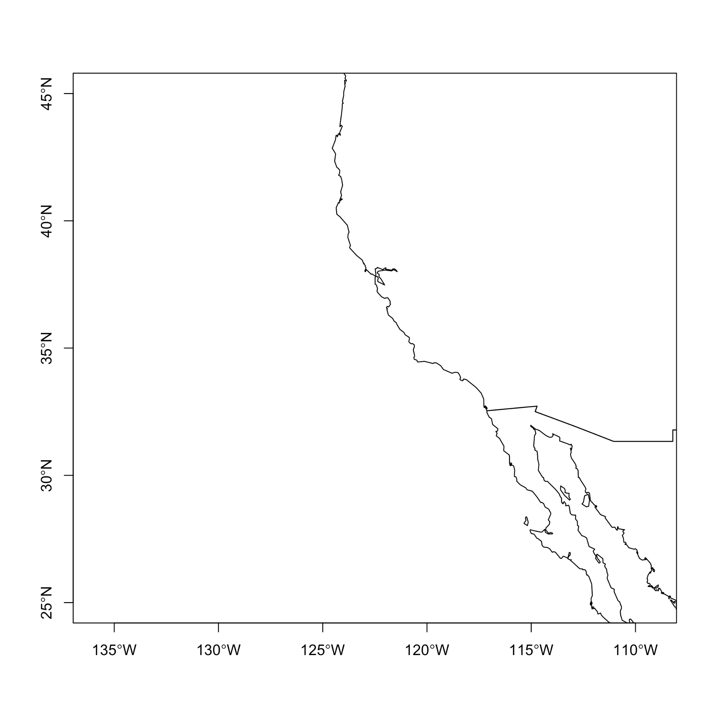


Slide 4
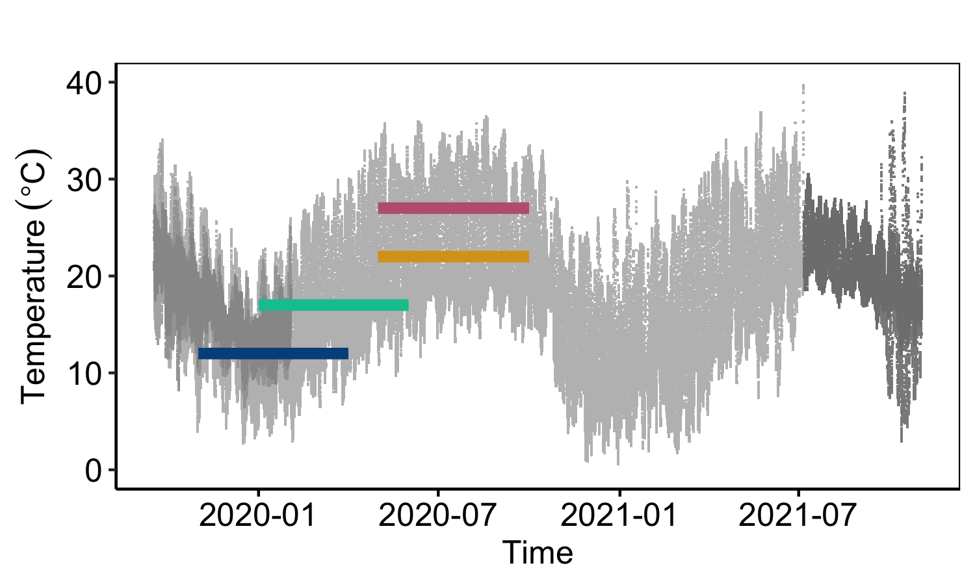
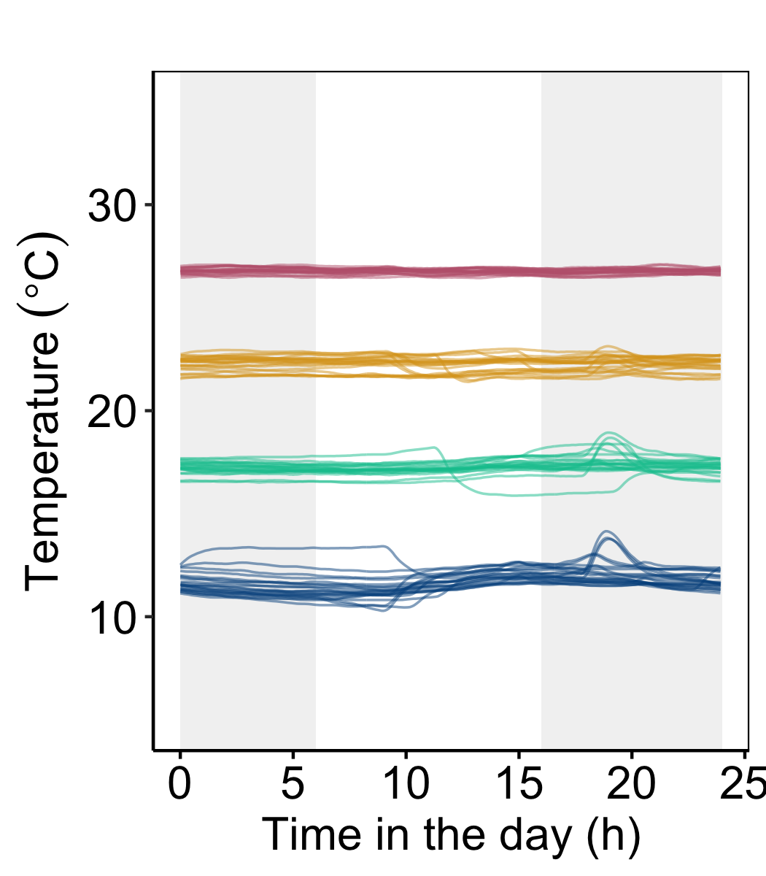
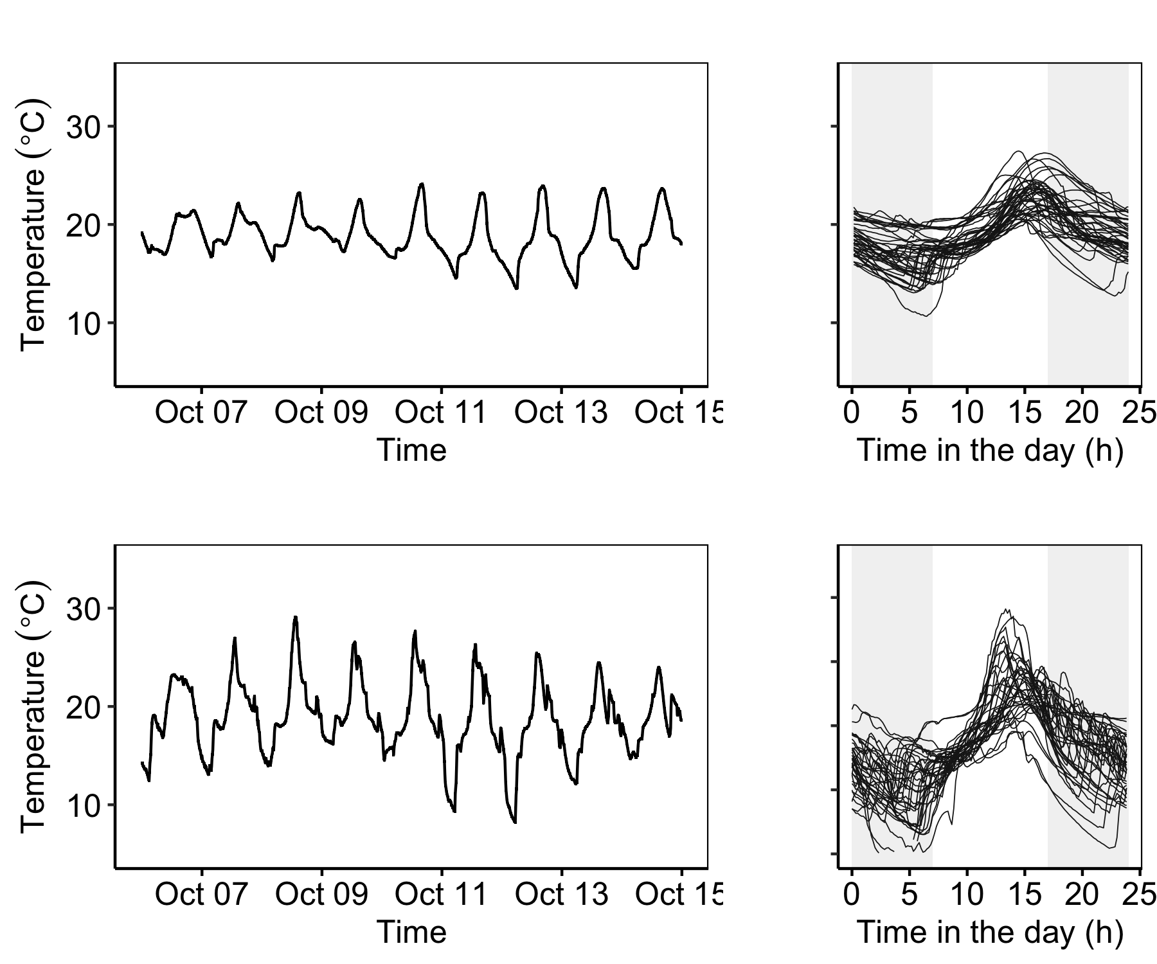
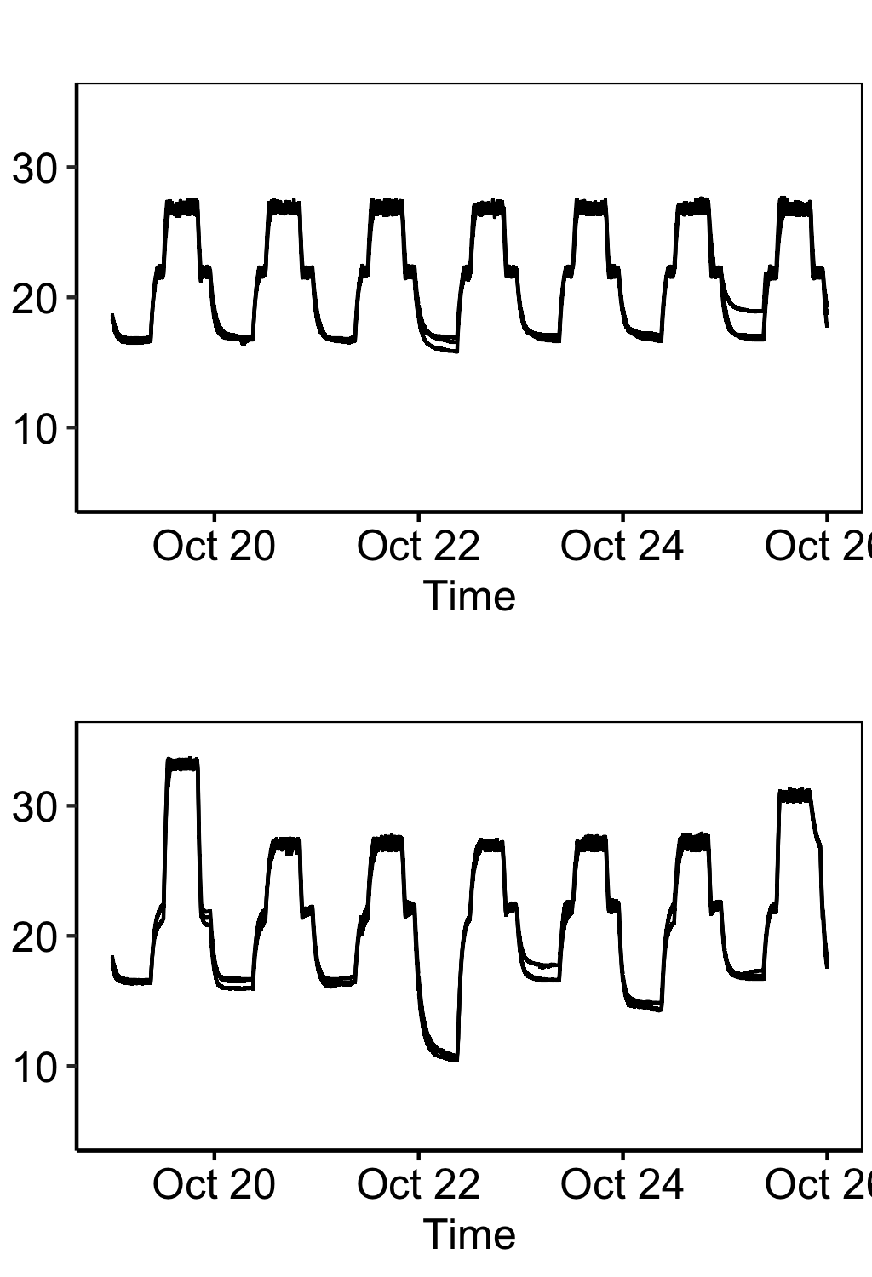
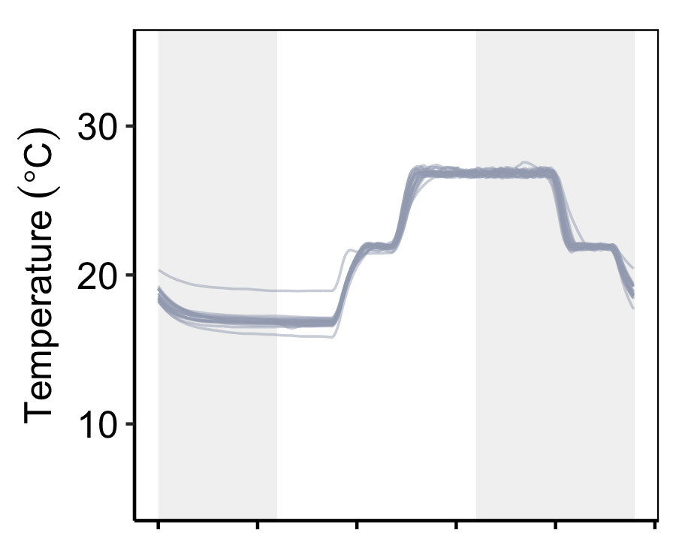

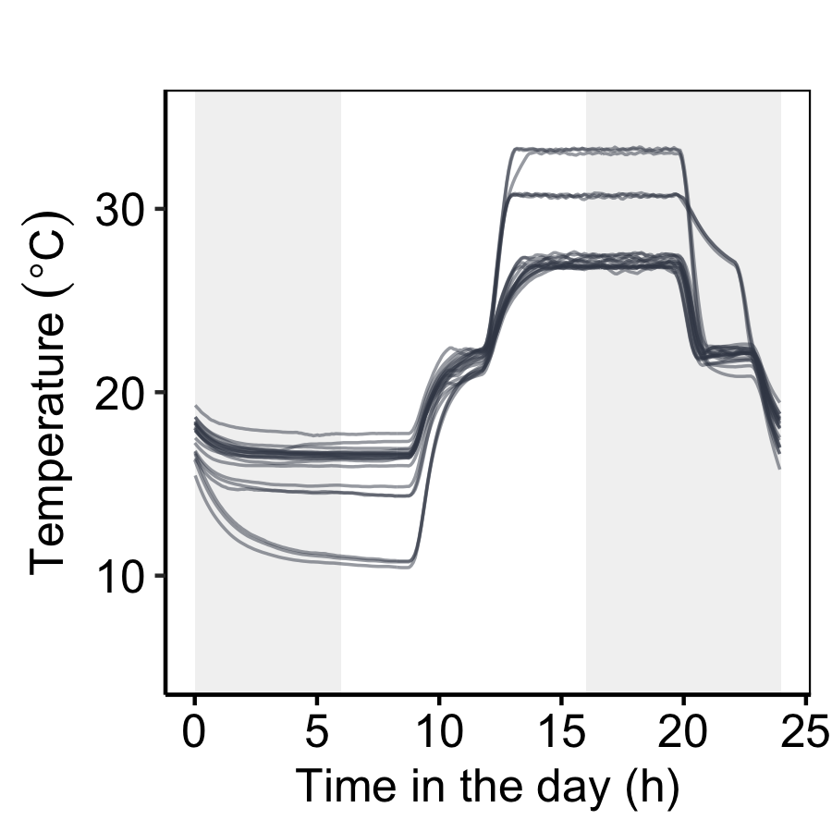
Field temperature acclimatization
Laboratory acclimations
day night
HOT 27ºC
WARM 22ºC
FROM FIELD TO LABORATORY
MEDIUM 17ºC
COLD 12ºC
FIELD
tests
V1 17 - 27ºC
Predictable, variable
max = 27ºC
mean = 22ºC
min = 17ºC
FROM FIELD TO LABORATORY
V2 17 - 27ºC
Irregular, variable
max = 32ºC
mean = 22ºC
min = 12ºC

Slide 5
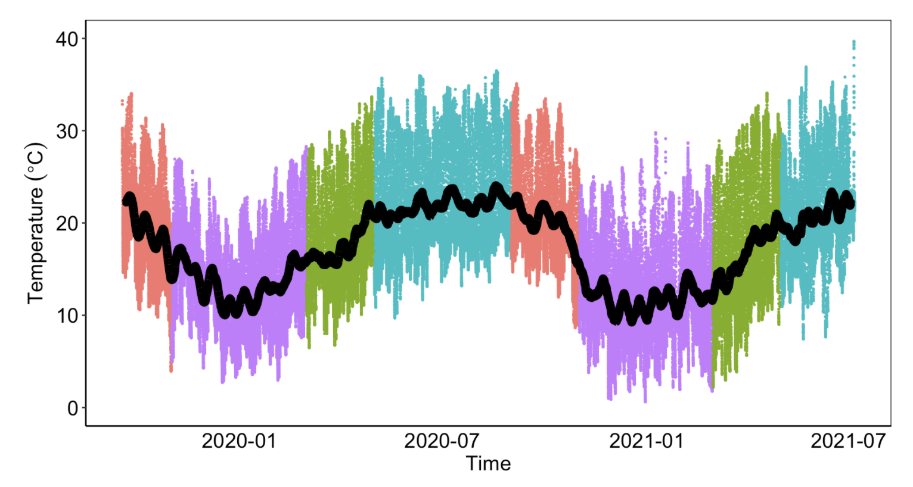
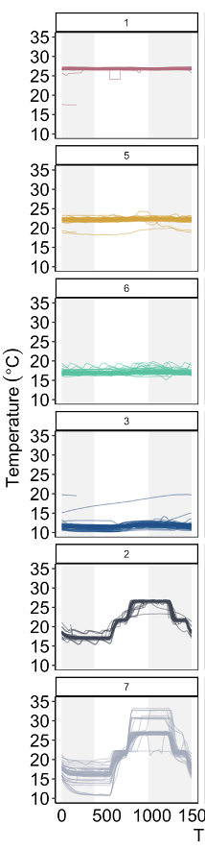
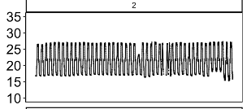
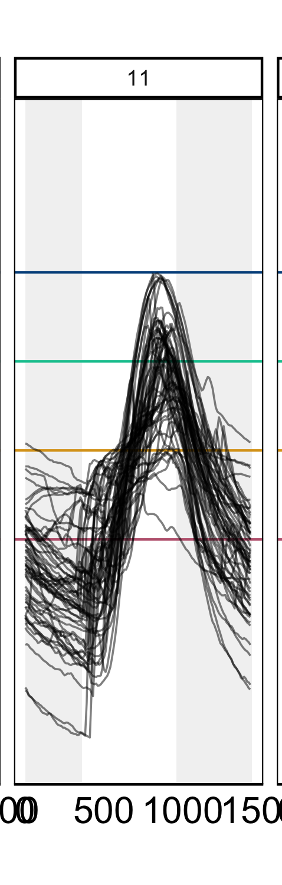
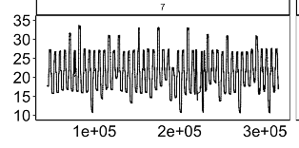
Laboratory acclimations
HOT 27ºC
WARM 22ºC
MED 17ºC
COLD 12ºC
V1 17-27ºC
V2 17-27ºC**
+ irregular swings

Slide 6
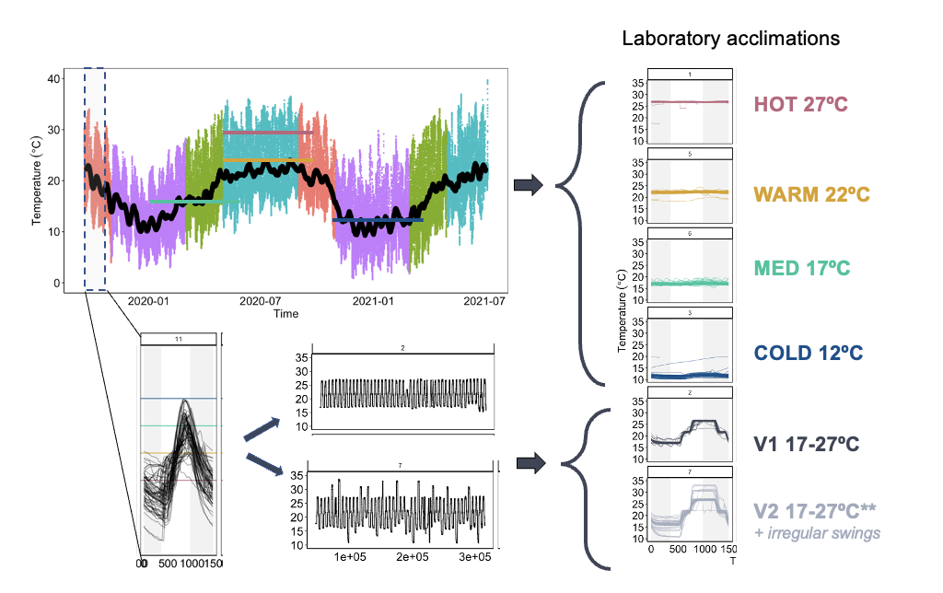

Slide 7
LAB THERMAL TOLERANCE

Slide 8
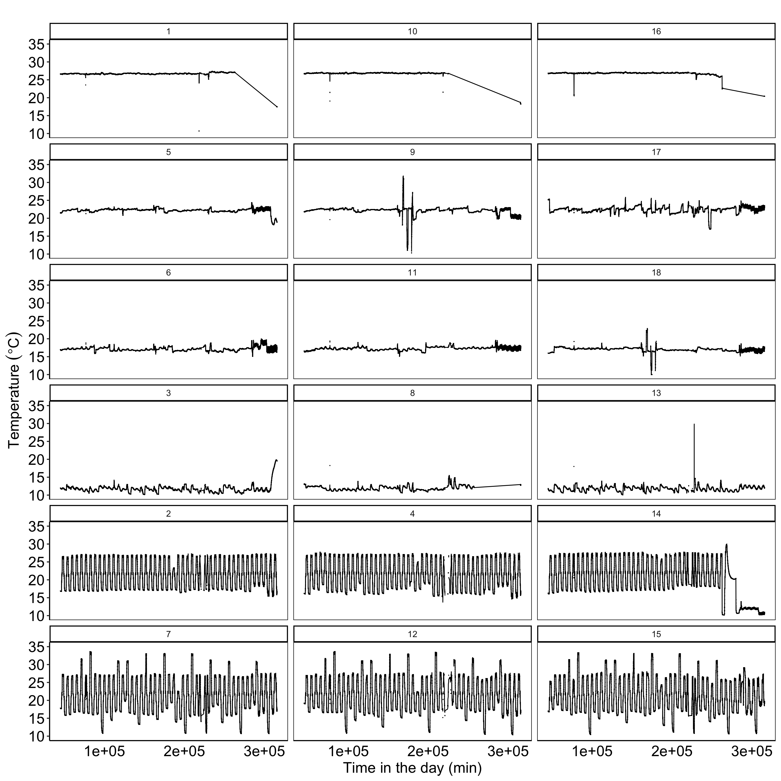
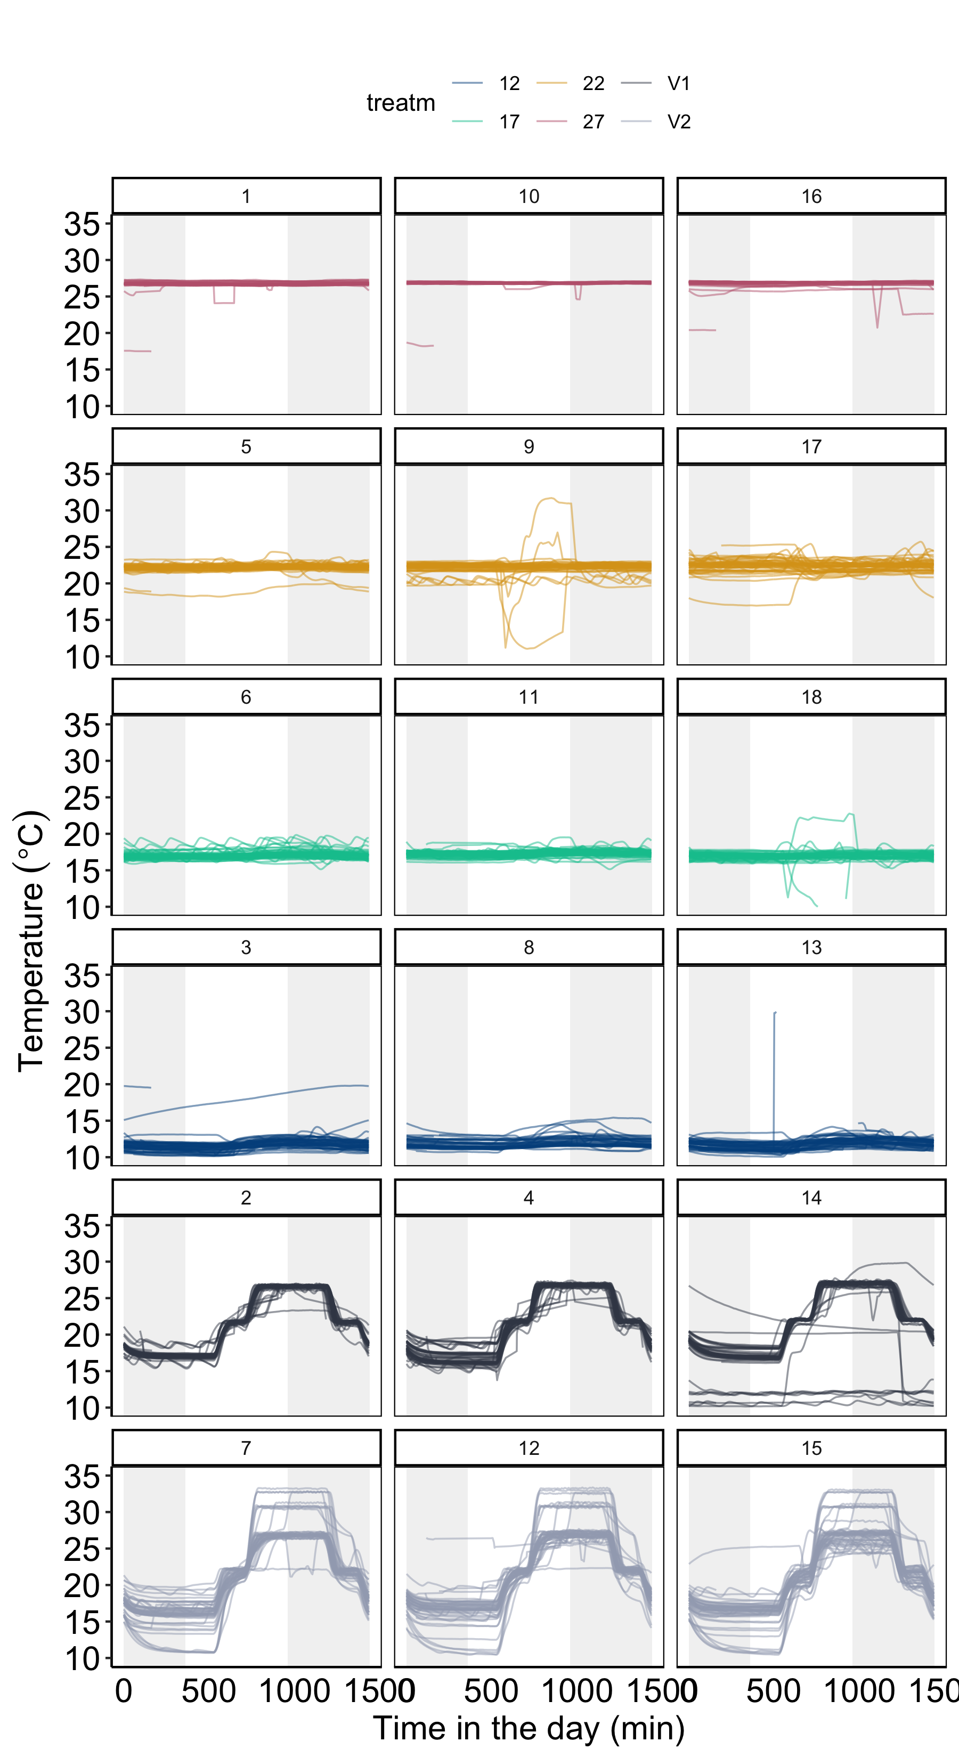
HOT 27ºC
WARM 22ºC
MED 17ºC
COLD 12ºC
V1 17-27ºC
V2 17-27ºC**
+ irregular swings

Slide 9
